Slide 1

Arrays and lists and such
Sit Dolor Amet

Slide 2
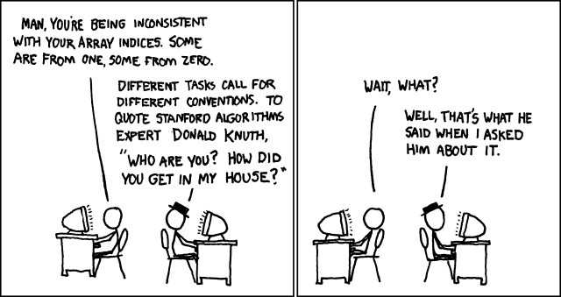
- Donald Knuth

Slide 3
What’s Wrong With this Picture?
var movies = new List<string>();
movies.Add("Crank");
movies.Add("The Expendables");
movies.Add("Furious 7");
movies.Add("Snatch");
movies.Add("The Meg");

Slide 4
What’s Wrong With this Picture?
var movies = new string[1];
movies[0] = "Crank";
var expandedMovies = new string[2];
movies.CopyTo(expandedMovies, 0);
expandedMovies[1] = "The Expendables";
var expandedExpandedMovies = new string[4];
expandedMovies.CopyTo(expandedMovies, 0);
expandedExpandedMovies[2] = "Furious 7";
expandedExpandedMovies[3] = "Snatch";

Slide 5
List vs Array
In C#, List<T> is really just an Array under the hood.

Slide 6
How do Array’s grow
// Adds the given object to the end of this list. The size of the list is
// increased by one. If required, the capacity of the list is doubled
// before adding the new element.
//
public void Add(T item) {
if (_size == _items.Length) EnsureCapacity(_size + 1);
_items[_size++] = item;
_version++;
}

Slide 7

Is this important?
Notes:
I’ve seen this crash servers before. (PAN, Airport report)

Slide 8
We have to be careful
Arrays and lists are just terms
The same rules don’t apply to all languages or environments

Slide 9
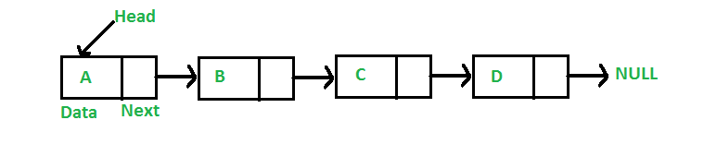
F#
List is actually a linked list

Slide 10
JavaScript
Array is an associative array

Slide 11
In JavaScript
const movies = [];
movies[9001] = "Dragon Ball Z";
Notes:
The length will tell you it’s over 9000, but it won’t necessary allocate the memory for each element. (but beware looping, because it will loop through all the undefined.);

Slide 12
In JavaScript (this is bad)
const movies = new Array(9000);

Slide 13
Skip list
An array structure that can provide indexer access
Also provides pointers to later elements for speed access
Notes:
William Pugh -> 1990

Slide 14
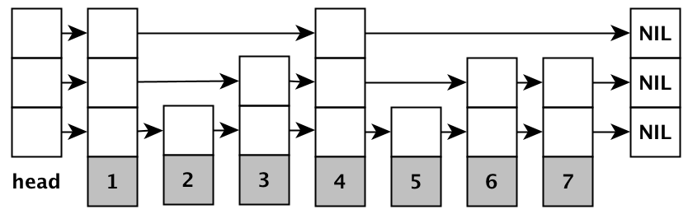
Skip list
Notes:
Think of it like paging

Slide 15
Sparse array
Use the object identifier as the indexer
An array becomes a hash table (dictionary) without the extra overhead

Slide 16
Sparse array

